Slide 1
What Factors can affect to student exam performance?
By: John Sevilla

Slide 2
Scope
For this project the scope of my question needed to be heavily limited
We’re Human!
Mental Health
Sleep
Medical Conditions

Slide 3
Getting and Exploring the Data
Overwhelming Amount of data sets and data
https://www.kaggle.com/datasets/whenamancodes/students-performance-in-exams/
Simplicity
Interesting Factors
Personal Connection
Small Data Set
Interesting Factors
Parental level of education
Test Preparation course

Slide 4
Questions
How did you come up with your question?
Initial Question: How does sleep impact student exam performance
Did your question evolve: Yes, once I saw the parent’s education level I decided to change
Hypothesis: I don't think that a parent’s education will affect their child’s test scores

Slide 5
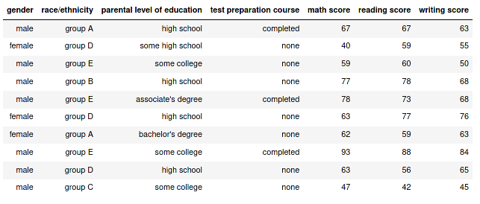
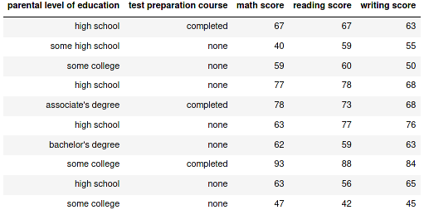
Wrangling the Data
Before
When Wrangling the data I wanted to keep the scope small
Gender
Ethnicity
Sleep
Economic Background
Divorced Households
After

Slide 6
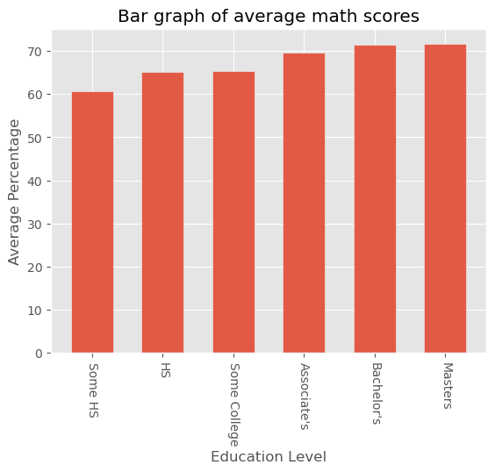
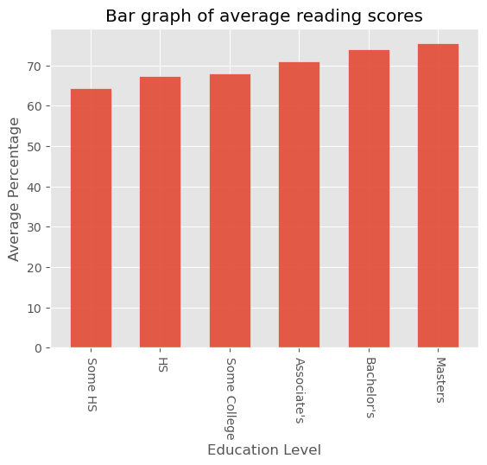
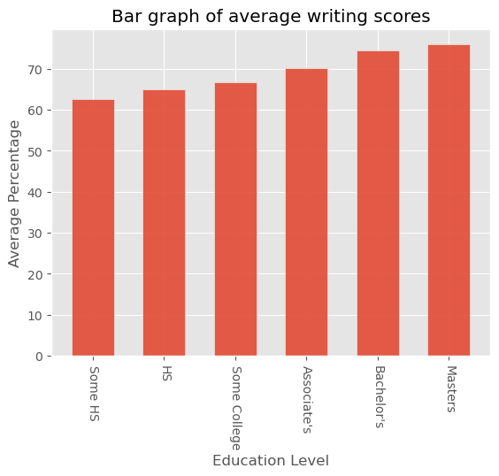
Data Results / Visualization - 1

Slide 7
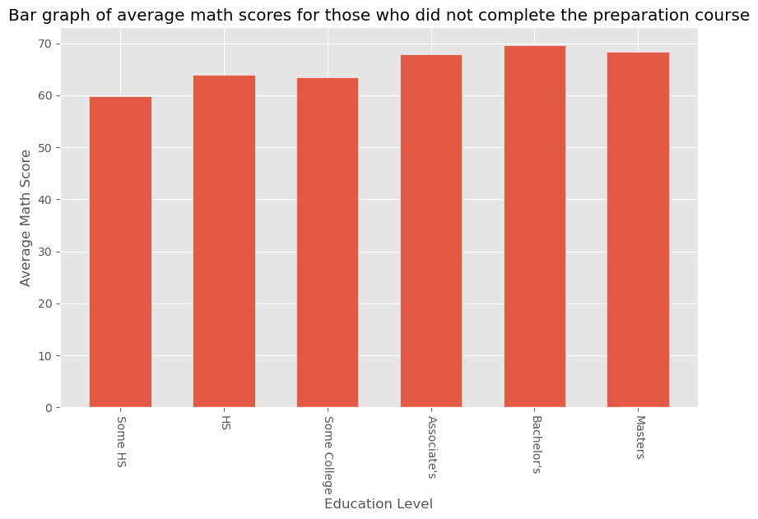
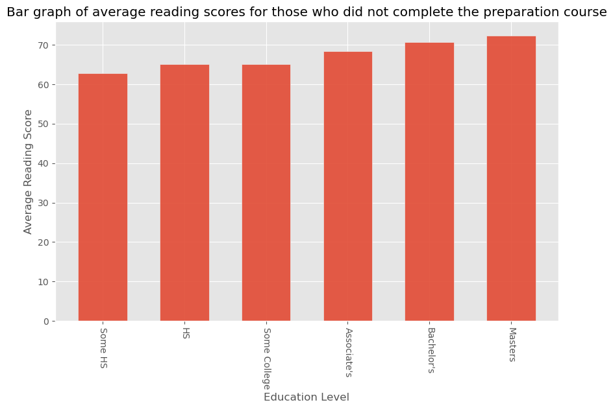

Data Results / Visualization - 3

Slide 8
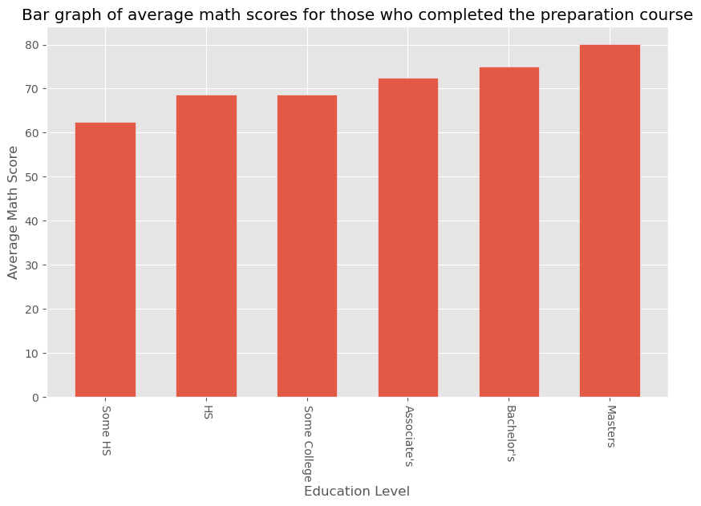
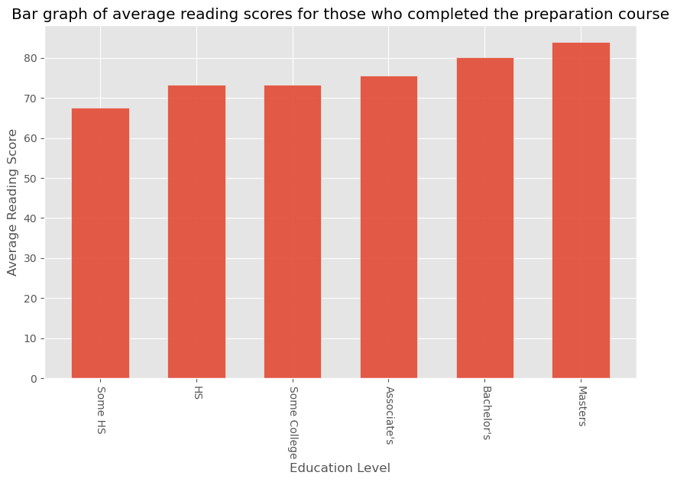
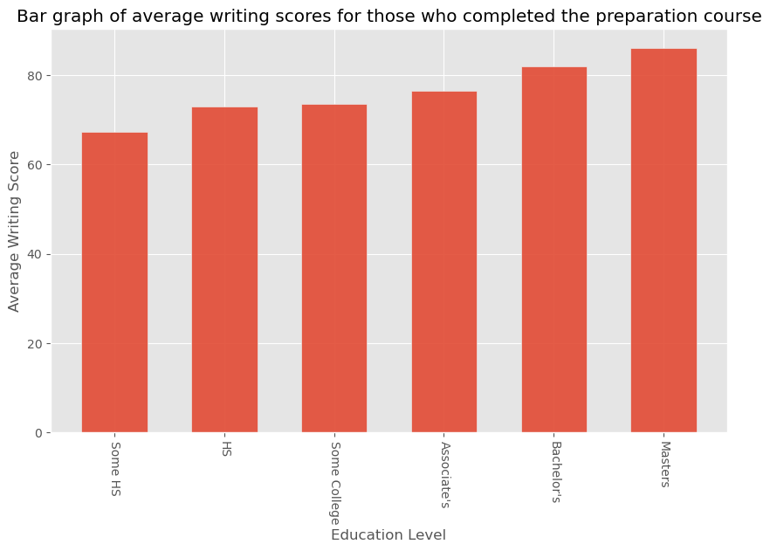
Data Results / Visualization - 2

Slide 9
Conclusion

